Slide 1
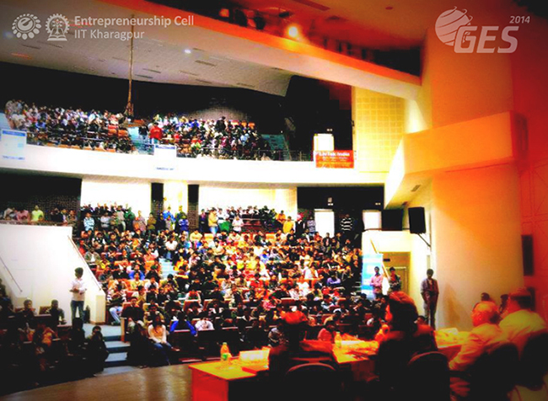
GES 2014@IIT.kgp
Megha Sharma, Anupriya Tuli & Gurpreet Singh
M.Tech (IT, 1st year)

Slide 2

What? Where? Why?

Slide 3

INTRODUCTION
The Global Entrepreneurship Summit 2014 ( GES) - the annual flagship event of the Entrepreneurship Cell IIT Kharagpur, which aims to provide a platform where promotion of entrepreneurship could be discussed with global perspective.
EVENTS:
Guest Lectures by various eminent personalities.
Workshops, focused on building the entrepreneurial acumen of participants.
The Global business plan competition, and the product design competition.
The video conferencing sessions.
Discussion amongst the Entrepreneurship Cells in India about the Indian scenario and how best to go about promoting entrepreneurship in their respective campuses.

Slide 4

EVENTS ATTENDED
Workshop by Taxmantra on “Taxation for Startups”
Workshop by Tech Mahindra on “Ideation and Concept Development”
Workshop by various Start-ups
Guest Lectures by :
Mr. Varun Agarwal,
Mr. Farrhad Acidwalla,
Mr. Rajat Sharma.
Attended Start-up Camp
Innovation Exhibition

Slide 5


Slide 6
START-UP CAMP
WEBEL- An initiative by government of West Bengal to provide capital for budding entrepreneurs.
EffiaSoft – Provides ERP solutions on cloud. Recognised by Microsoft as a BizSpark startup. Email-id: www.effiasoft.com
Anant Computing - Vernacular apps those run on every OS
Rang De - NGO fights poverty with an entrepreneural setup
Avyam – Making shopping simple and fun
BetaGlide - Higher ratings, more customers, and efficient apps
GainWaste – Recycling of waste
Menily – Developing a cloud based platform to connect people with healthcare units and doctors

Slide 7


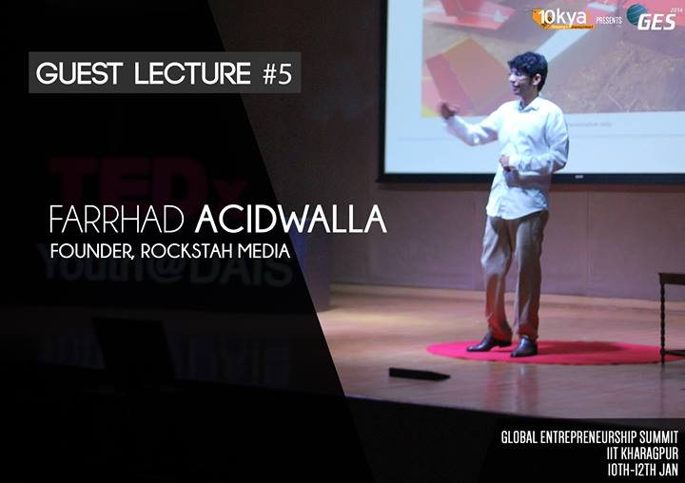
Journey from being a common man to a successful entrepreneur
People from various walks of life shared their journey to success.

Slide 8

Failures are stepping stones to success…

Slide 9

Our Learnings

Slide 10
OUR LEARNINGS
Owning a start-up is no rocket science.
Idea can be as basic as garbage recycling (GainWaste).
Age is no boundary for being a successful entrepreneur.
In present scenario, the domain of Entrepreneurship is not limited to chambers of commerce as the entrepreneurship summit was dominated by technical people.
Earlier, the domain of Entrepreneurship was limited to chambers of commerce. But, the largest student entrepreneurship summit was dominated by technical people.
Inspiration & Motivation to try and develop something unique.
Innovation is the key to success in today’s competitive world.
Failures are stepping stones to success.

Slide 11
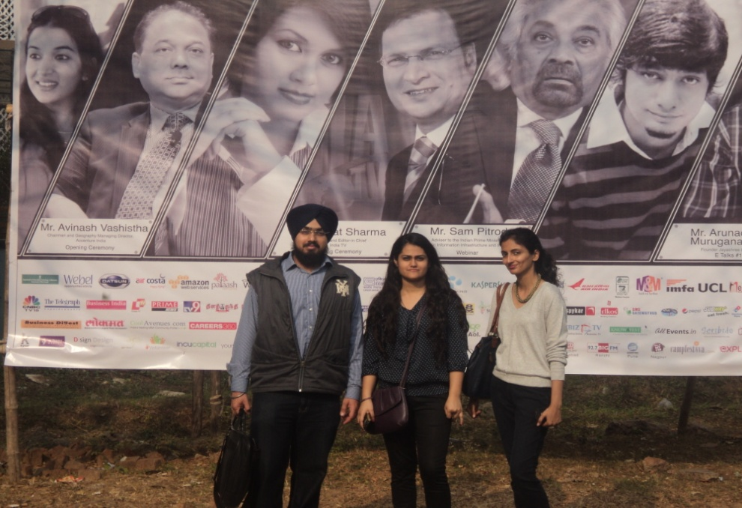
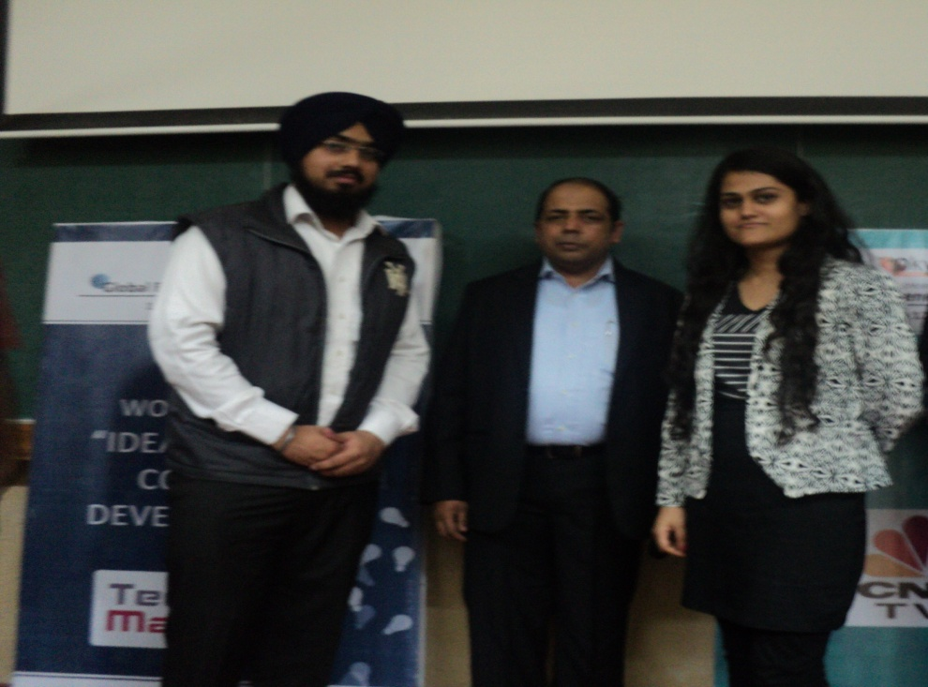
GALLERY

Slide 12
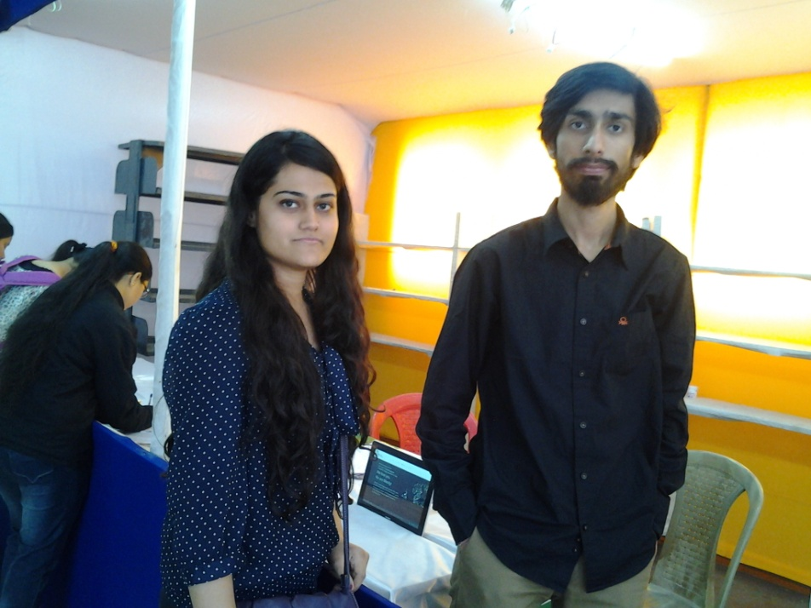
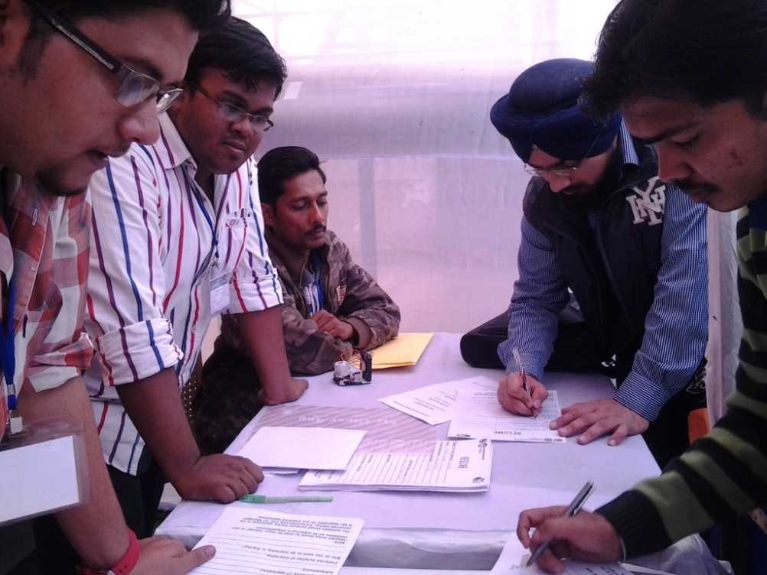
GALLERY

Slide 13

Thank You !

